Slide 1
Real Time Image Attendance System Through Face Detection
TEAM MEMBERS:
19K41A0589-SRAVANI 19K41A05A5-BINDHU 19K41A05A7-VAMSHI 20K45A0508-AFREED

Slide 2
ABSTRACT:
This project is based on real time attendance using image processing technique.
The concept of our project is to provide real time attendance of students in the class to the faculty’s data base.

Slide 3
INTRODUCTION:
Attendance is a necessary parameter which is required is most of schools and colleges.
On an average this attendance is carried out to have accurate count of people or students seating in a particular classroom or any practice area.
Traditional method of taking this attendance carried out by humans where the lecturer or teacher manually counts each and every student with their required data like candidate’s name, serial number, status etc.
This process is very much time consuming and maintenance of collected data is difficult.
Thus we can digitized the process of taking attendance and make it simple and accurate.
Our project will digitize the process of attendance collection by using image processing technique and will automatically update real time data of faculty’s data base.

Slide 4
Working:
A facial recognition software captures and compares patterns on face and analyses the details to identify and verify the individual.
1.Face detection : an essential step in locating human faces in real-time
2. Transforms data: once captured , the analogue facial information is transformed into a set of data or vectors based on a persons facial features
3. Face match: the system matches the data above with the one in the database for verification

Slide 5
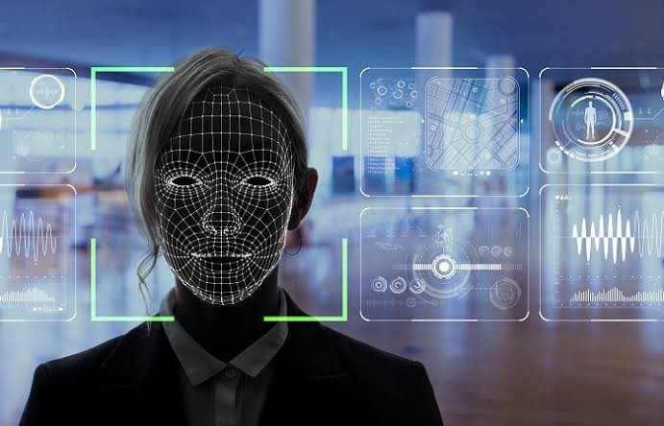
Model:

Slide 6
CONCLUSION:
On considering requirement of simple, fast and accurate attendance system.
we have designed a digitized attendance system which can accurately send real time data and provides easy and quick access of attendance to faculties.

Slide 7
THANK YOU

